Slide 1
A Global Perspective on Greening the Transport Sector
Sustainable Mobility and Integrated Planning in Urban Areas
February, 2013

Slide 2
Even in the most optimistic scenarios, transportation is expected to be highly dependent on oil in the next two decades
2010 Transport Energy Consumption
2030 Transport Energy Consumption
Repowering Transport – Rapid Deployment Scenario
94% fossil sources
Total = 2,200 Mtoe
76% fossil sources
Total = 2,500 Mtoe
Biofuels
Electricity
Electricity
LPG/CNG
3%
Residual
1%
Biofuels
Gasoline
1%
Gasoline
Jet
13%
39%
46%
LPG/CNG
Residual
8%
Jet
28%
Diesel
23%
Diesel
Source: IEA / SMP, IMO, IATA, Carbon Neutral Skies team analysis, Repowering Transport team analysis
Notes:
Mtoe – Million tones of oil equivilant

Slide 3
Opportunities &
Challenges
Source: World Economic Forum

Slide 4
Principles shared by all stakeholders support an integrated systems approach to sustainability in transportation
Guiding
principles for environmental
sustainability in transportation
Policy
Financing
Energy sources
Infrastructure
End customer information
Best practices from pilots and trials
Policy framework should:
Consider implications on other modes and sectors
Be transparent, predictable, coordinated
Provide appropriate support for sustainable technologies
Financing decisions should consider:
Long-term social, environmental, and governance factors
Opportunities for collaborative de-risking
Financial aid as opportunity for economic growth
Energy sources should be:
Cost effective and sustainable
Sustainable from environmental, social and economic perspective
Measured based on harmonized life-cycle environmental assessments
Infrastructure investments should consider:
Ability to improve utilization and integrate existing infrastructure
Trade-offs between technologies and impact on other modes
Impact on urban planning and programs in other sectors
End customers need:
Access to sustainable transportation alternatives
Information on life-cycle environmental impact and cost
Information that is granular, verifiable, available, comparable, and understandable
Source: World Economic Forum, Sustainable Transport Ecosystems

Slide 5
The principles can be applied to develop action plans for specific sustainability levers in transportation
Example: Vehicle electrification
Guiding
principles for environmental
sustainability in transportation
Policy
Financing
Energy sources
Infrastructure
End customer information
Best practices from pilots and trials
Policy makers
Financial and non-financial support and incentives (e.g. zero emission zones, bus/taxi lanes)
Mandating government fleets as early adopters
Educate consumers (e.g. TCO)
Financial institutions
Develop new financing models
Build in-house capabilities around
e-technologies to ensure attractive market offerings
Foster and encourage start-up players
Academia
Invest in R&D of more sustainable technologies
Energy providers
Develop commercial offerings to support mass-market adoption
Support collaboration with industry peers and start-up players
Energy providers
Identify bottlenecks in distribution/last mile and upgrade grid
Policy Makers
Review electric grid regulation to ensure cost efficient and speedy deployment
Expand public charging infrastructure.
Collaborate to push technology standardization
End customers
Push OEMs for transparent information
Communicate need for infrastructure
Industry organi-zations/NGOs/OEMs
Educate total cost of ownership of vehicles
Source: World Economic Forum, Sustainable Transport Ecosystems

Slide 6






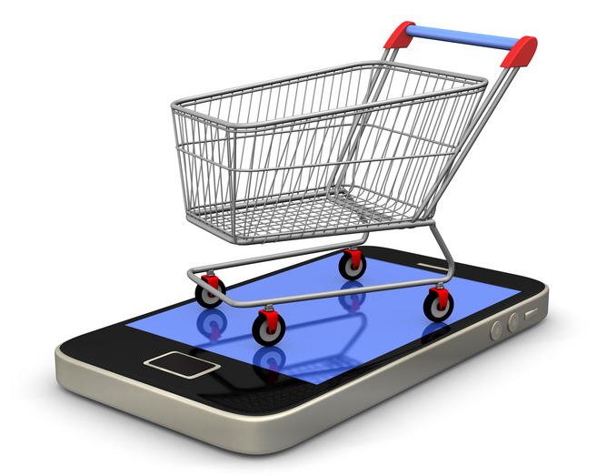

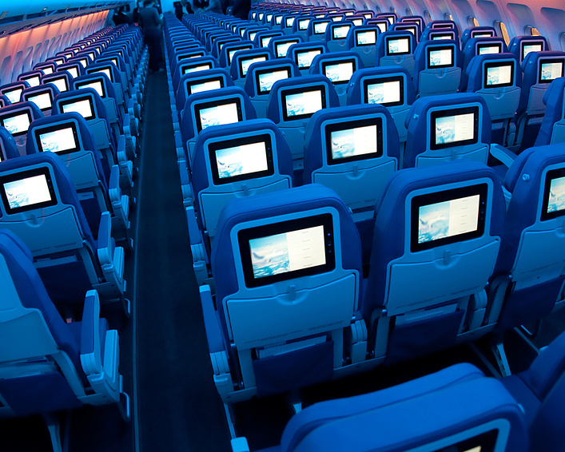



Potential beyond traditional transport technologies is mainly expected from new ICT and consumer trends
Megatrends
Solutions for connected mobility
Cloud Solutions/Big Data Analytics
Mobile Connectivity
3.0
Benefits to society (by 2025)
Condition-based megacity
traffic management
Tracking- and transparency-based
logistics optimizer
Internet of Things/ Smart Transport
E-/M-Commerce & Multichannel Retail
Fully automated check-in,
security and border control
Integrated proactive intermodal
travel assistant
Information & Enter-tainment Everywhere
Social Media/Web 2.0
Emergence of Megacities
Seamless User Experience
Business opportunity (by 2025)
Source: World Economic Forum, Connected World

